Slide 1
2024-03-20 SEM-07 samples AA, AB, AC
Gottfrid Olsson

Slide 2
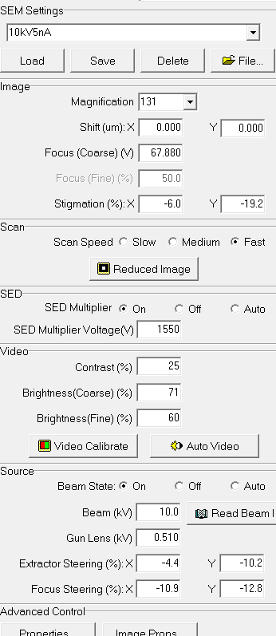

Slide 3
Sample AA: 0.020 mAh/cm2

Slide 4
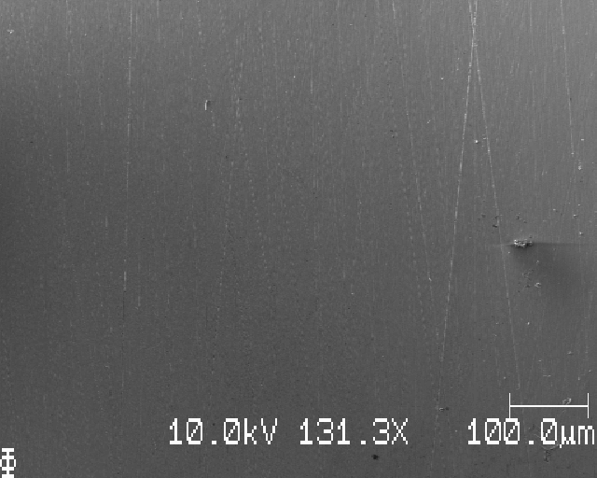
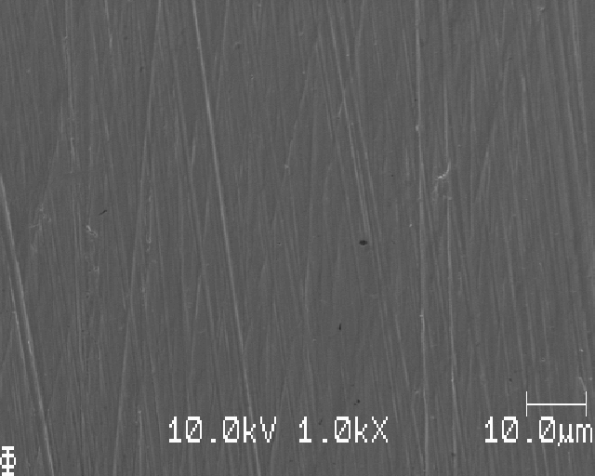
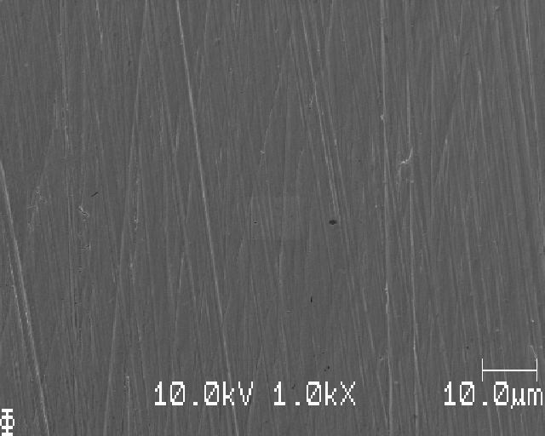
Closest to edge of sample

Slide 5
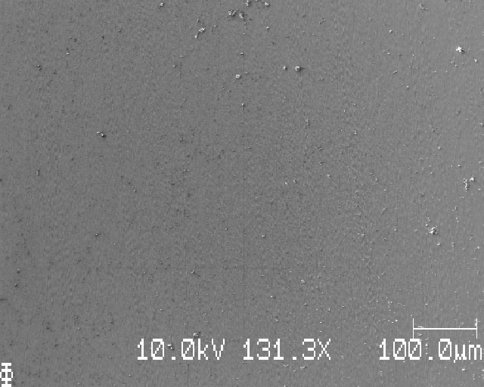
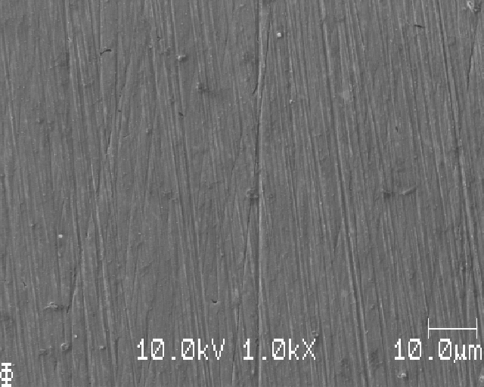
2 mm from edge

Slide 6
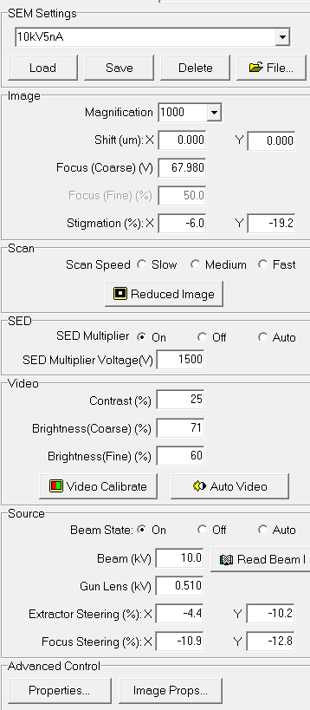
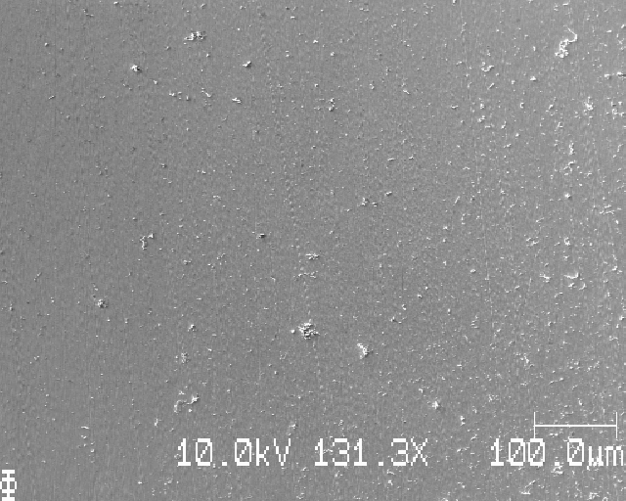
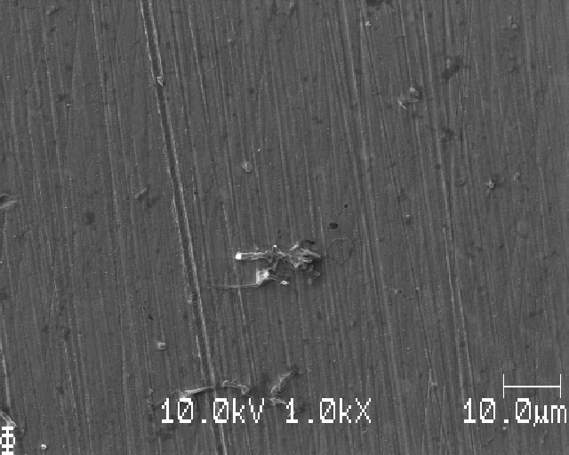
Edge of deposition

Slide 7
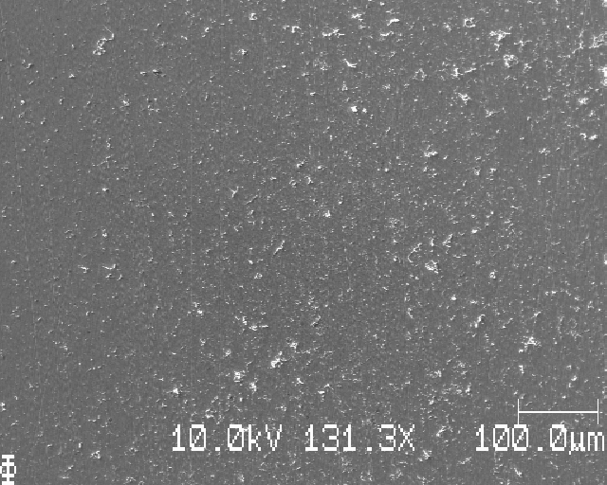
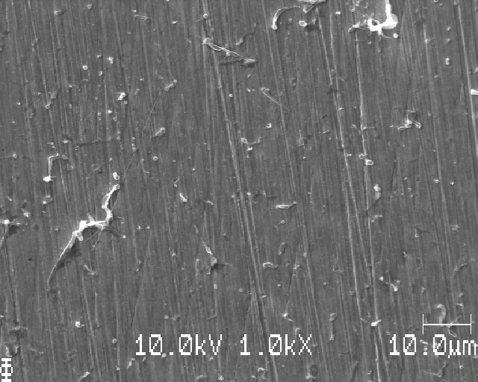
Deposited Li, I

Slide 8
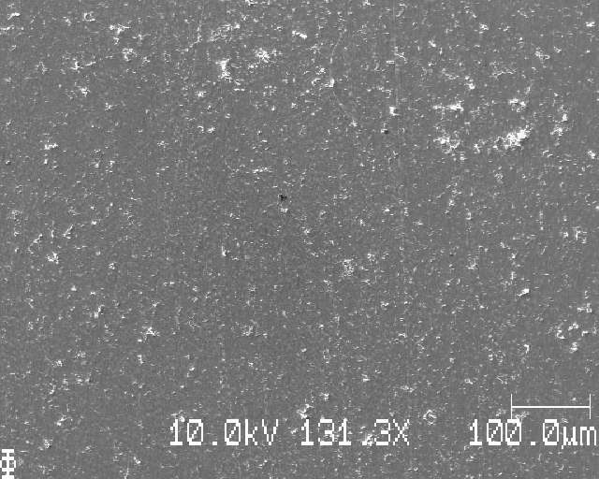
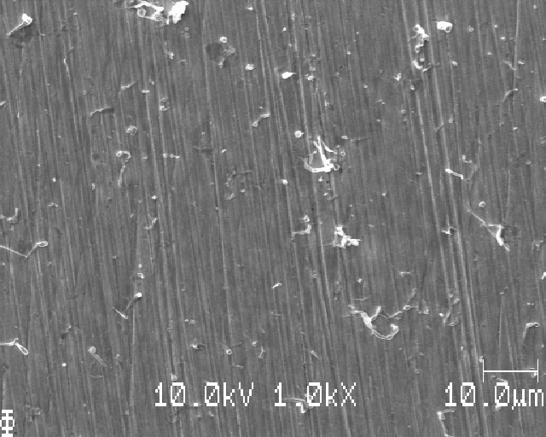
Deposited Li, II

Slide 9
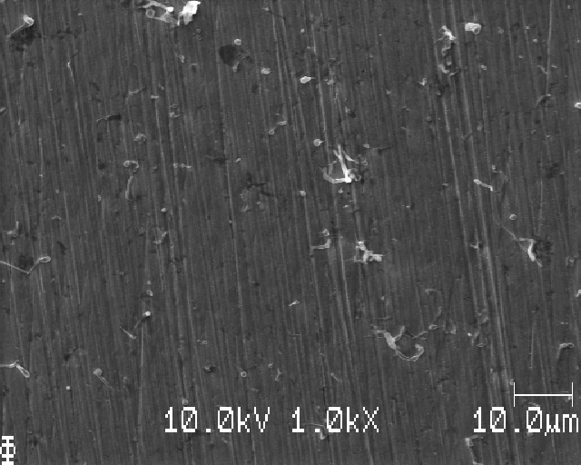
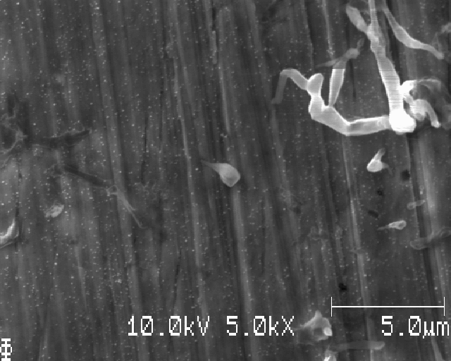

Slide 10
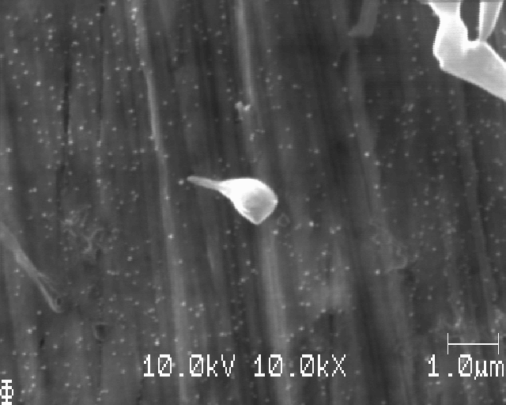
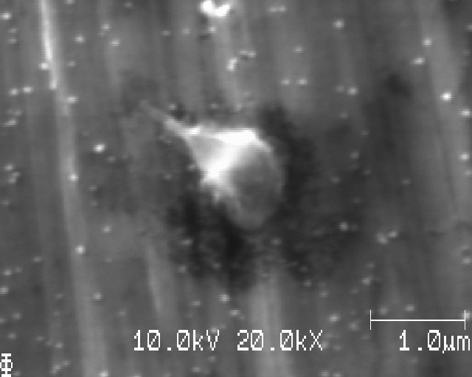

Slide 11
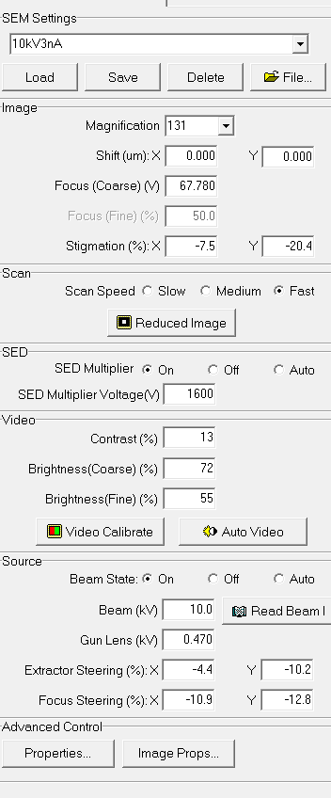
Test 10kV 3nA

Slide 12
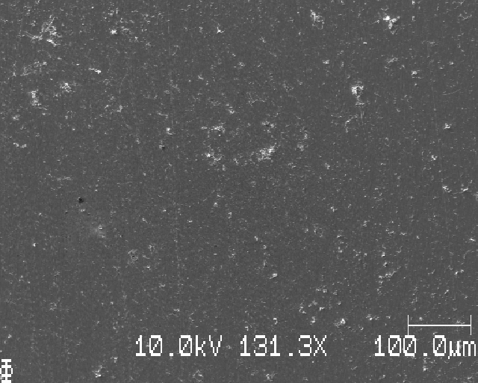
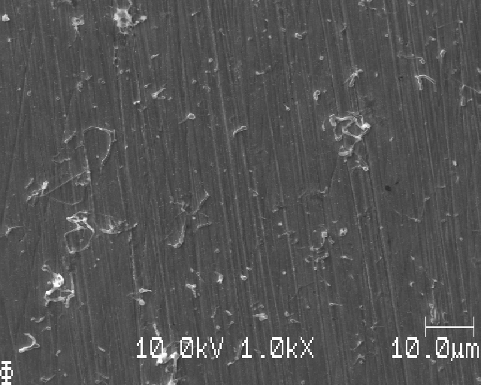
Deposited Li, III

Slide 13
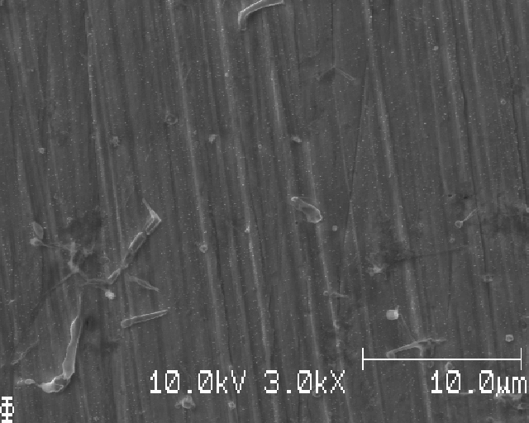
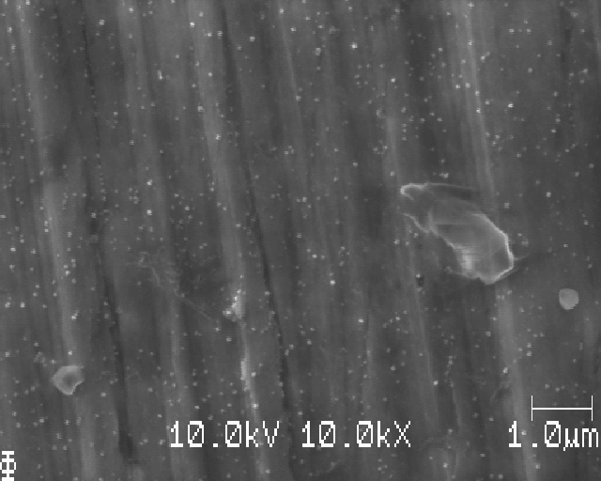
Deposited Li, III (continued)

Slide 14
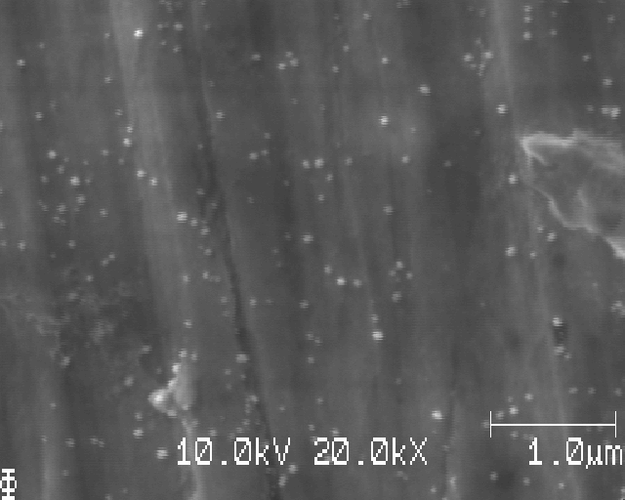
Deposited Li, III (continued)

Slide 15
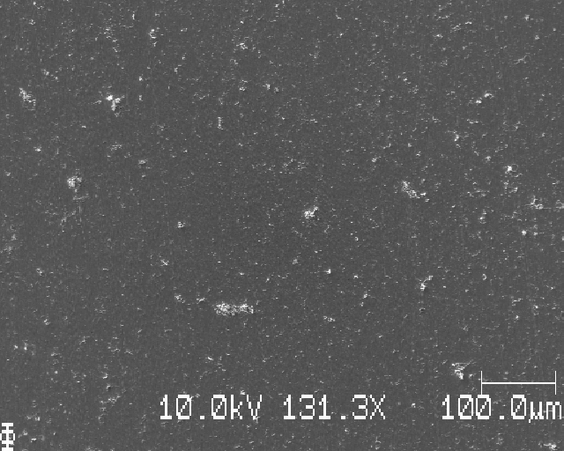
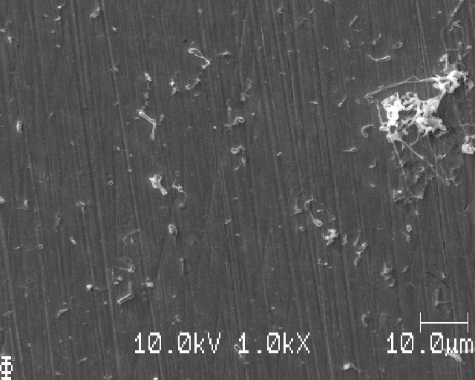
Deposited Li, IV

Slide 16
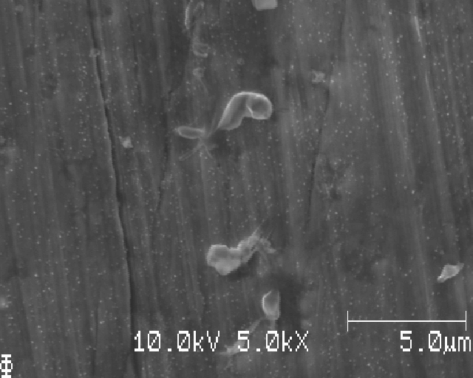
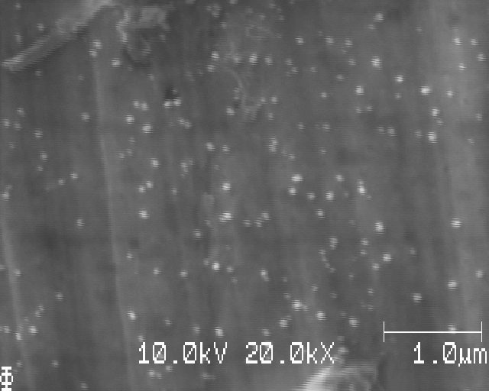
Deposited Li, IV (continued)

Slide 17
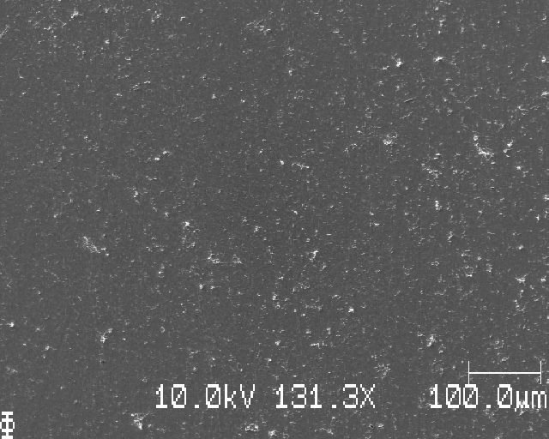
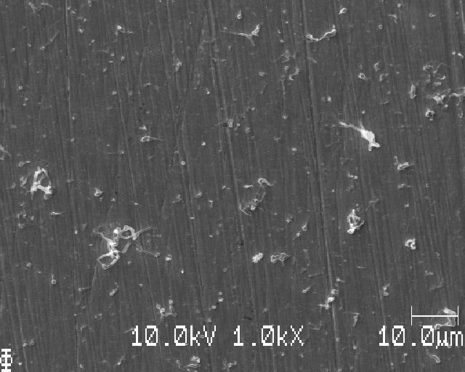
Deposited Li, V

Slide 18
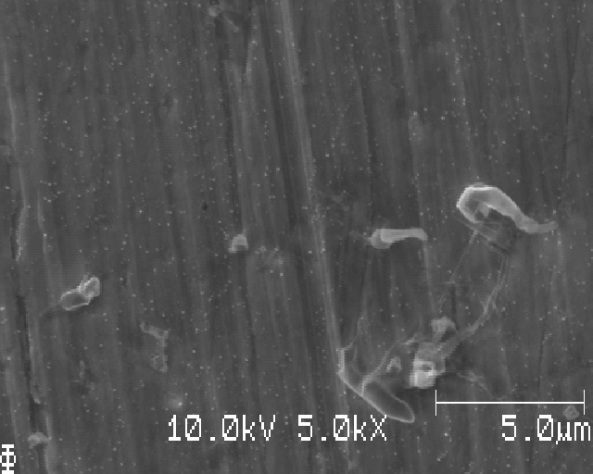
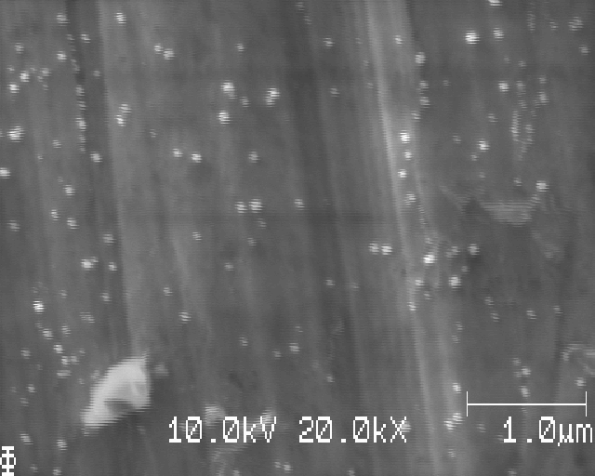
Deposited Li, V (continued)

Slide 19
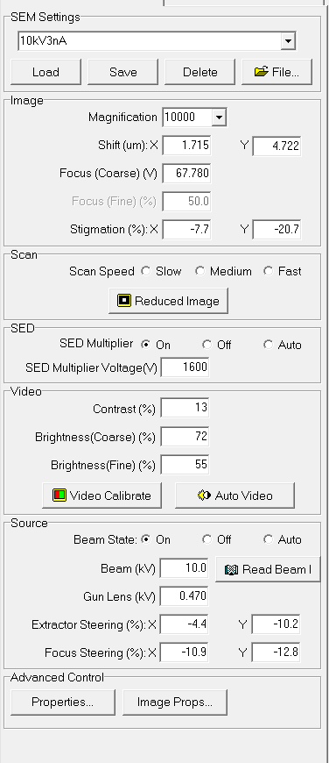

Slide 20
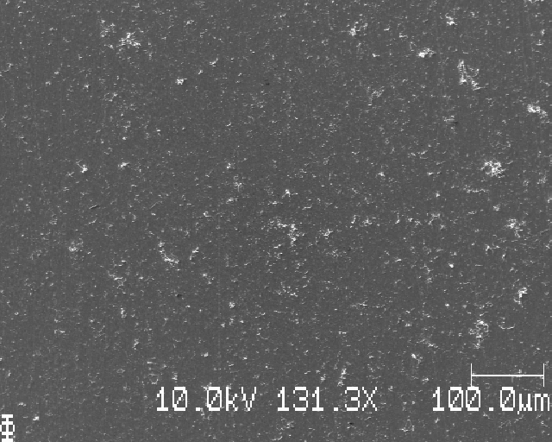
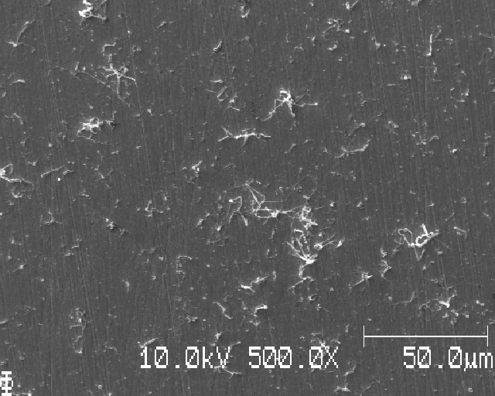
Deposited Li, VI

Slide 21
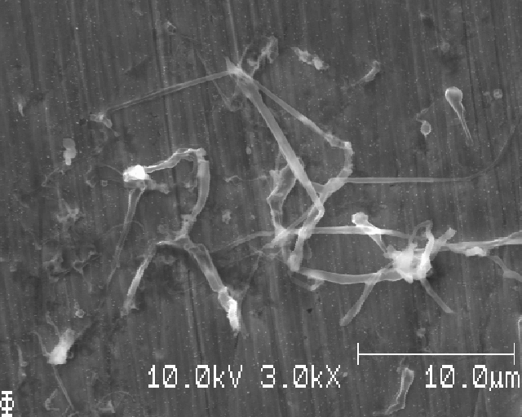
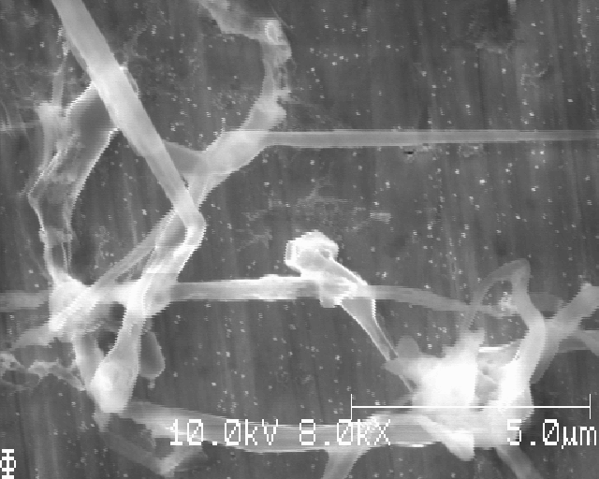
Deposited Li, VI (continued)
Shaky lines due to sample/stage motion during raster scan…

Slide 22
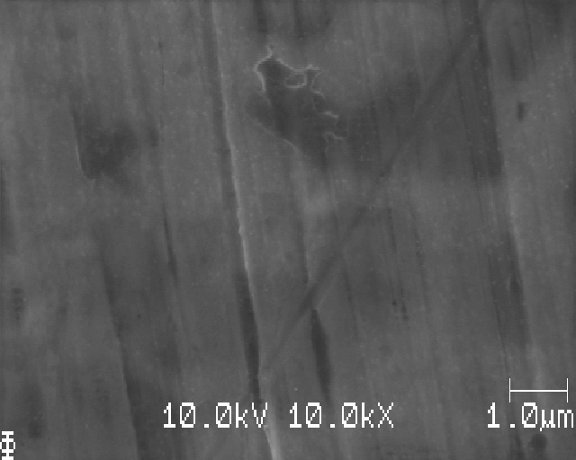
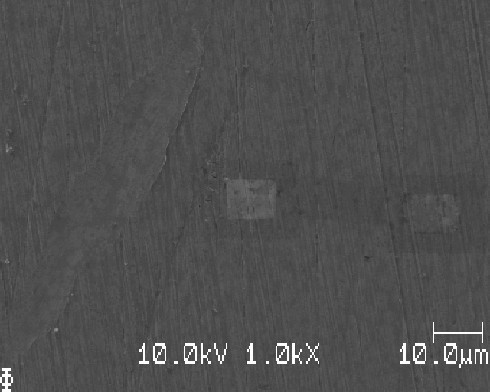
Large magnification far from Li deposition zone (right image is less magnification)

Slide 23
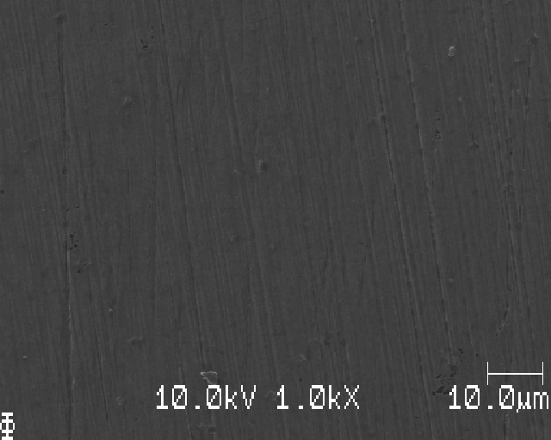
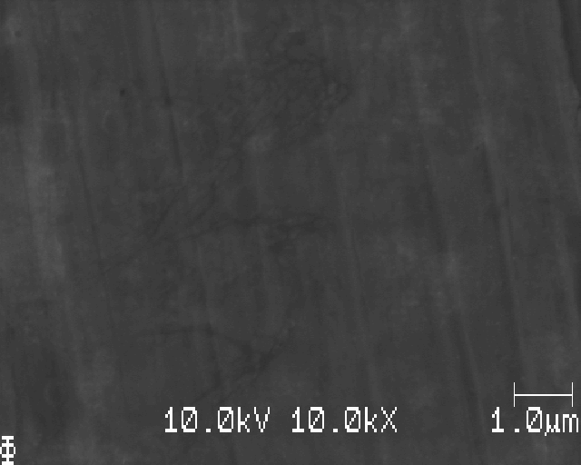
One more, 0,5 mm from edge of sample

Slide 25
Sample AB: 0.015 mAh/cm2

Slide 26
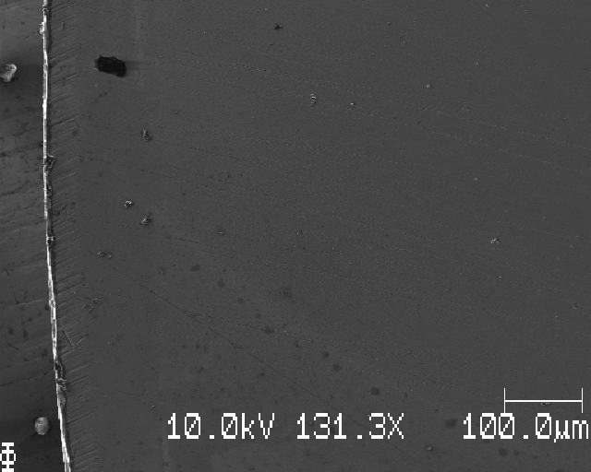
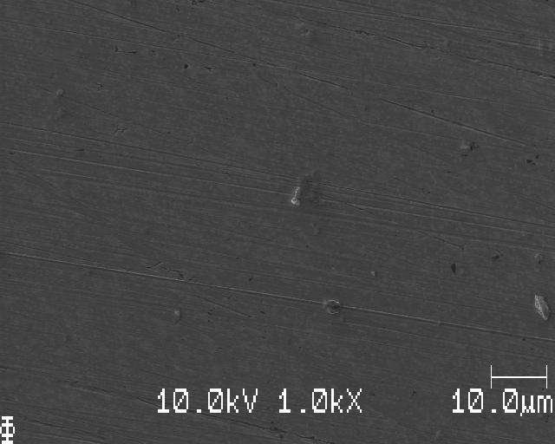
Edge

Slide 27
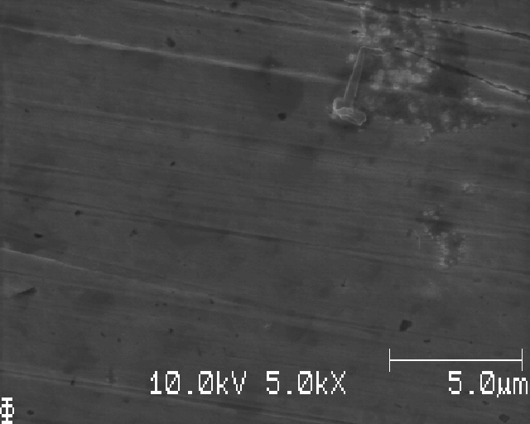
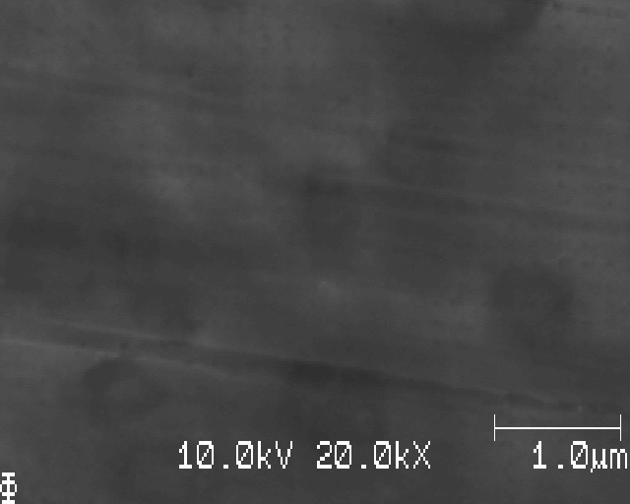
Edge (cont.)

Slide 28
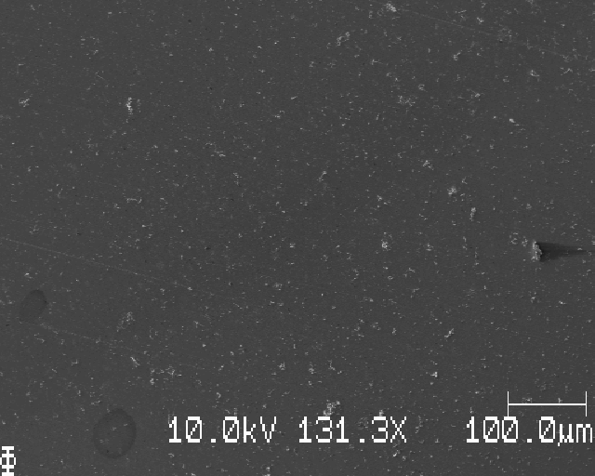
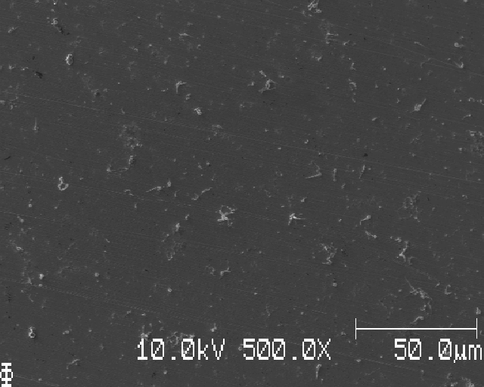
A bit in from edge of deposition

Slide 29
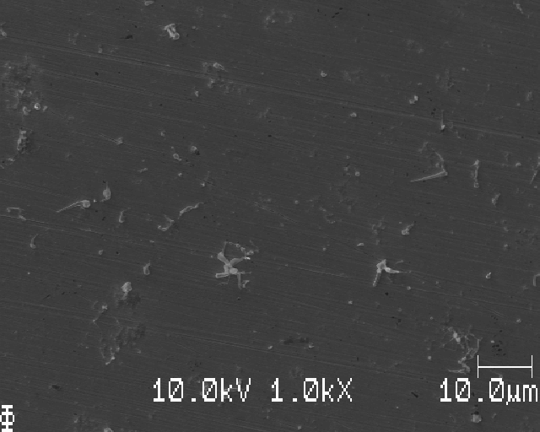
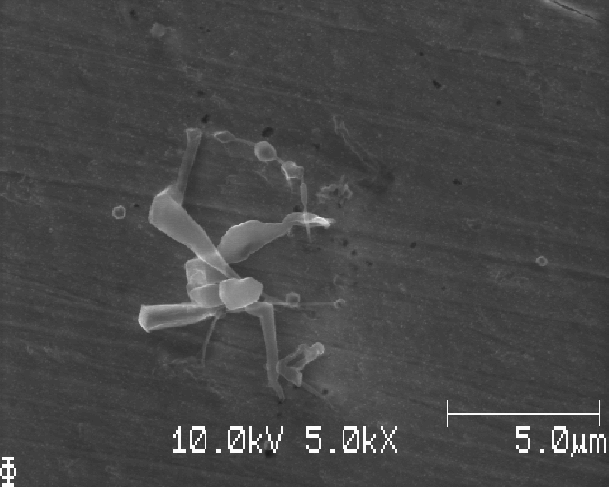
A bit in from edge of deposition (cont.)

Slide 30
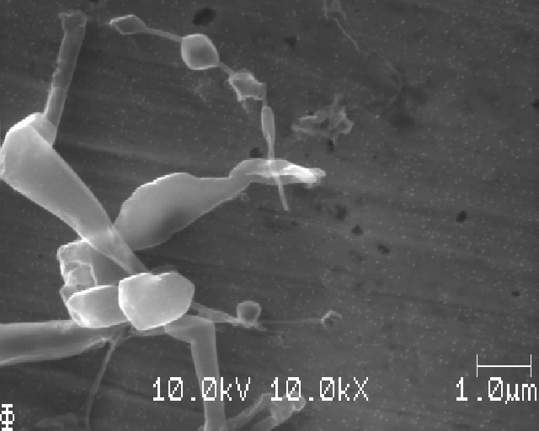
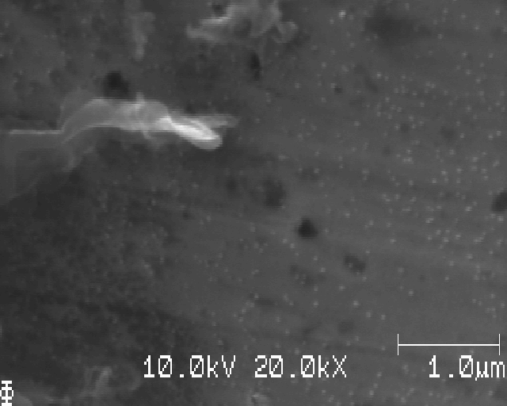
A bit in from edge of deposition (cont.)

Slide 31

A bit in from edge of deposition (cont.)

Slide 32


Deposition of Li, I

Slide 33


Deposition of Li, I (cont.)

Slide 34


Deposition of Li, I (cont.)

Slide 35


Deposition of Li, II

Slide 36


Deposition of Li, II (cont.)

Slide 37

Deposition Li, II (cont.)

Slide 38


Deposition Li, III

Slide 39


Deposition Li, III (cont.)

Slide 40


Deposition Li, III (cont.)

Slide 41


Deposition Li, III (particles)

Slide 42



Slide 43


Slide 44


Deposition Li, IV

Slide 45


Deposition Li, V

Slide 46


Deposition Li, V (cont.)

Slide 48
Sample AC: 0.010 mAh/cm2

Slide 49

Edge

Slide 50

2-3mm from edge

Slide 51


2-3 mm from top edge of sample, shite (bubbles)

Slide 52


Same spot, later

Slide 53

Dirty surface, despite same washing process for all three samples (AA, AB and AC)

Slide 54


Area without or with little dirt/salt

Slide 55


zoom

Slide 56


Another place

Slide 57


Another place zoom

Slide 58


Slide 59


Another place,

Slide 60



Slide 62


Josef Kalium prov (kanten i left image is where the sample was cut in two through the center)

Slide 63



Slide 64



Slide 65


Several mm from center of sample

Slide 66



Slide 67

Very nice hexagonal crystal

Slide 68


Edge of deposition

Slide 69


Slide 70


Closer to edge of deposition

Slide 71



Slide 72




Lower center

